Slide 1
CORE JAVA DAY12
NEEHARIKA

Slide 2
Java Collections class
Java collection class is used exclusively with static methods that operate on or return collections. It inherits Object class.
The important points about Java Collections class are:
Java Collection class supports the polymorphic algorithms that operate on collections.
Java Collection class throws a NullPointerException if the collections or class objects provided to them are null.

Slide 3

Collections class declaration

Slide 4
Java Collections synchronizedCollection()

Slide 5
Sorting in Collection
We can sort the elements of:
String objects
Wrapper class objects
User-defined class objects

Slide 6
Method of Collections class for sorting List elements
public void sort(List list): is used to sort the elements of List. List elements must be of the Comparable type.

Slide 7
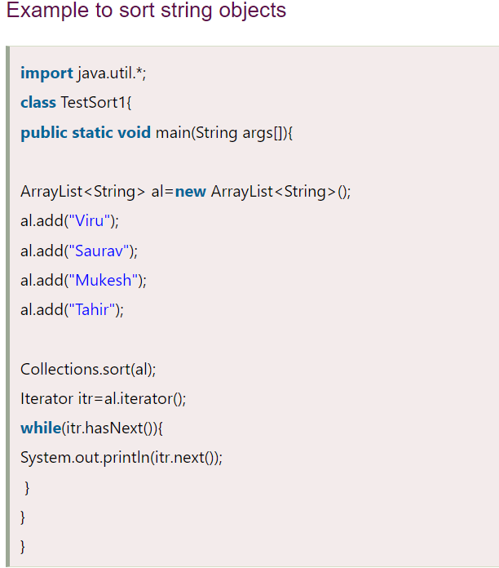

Slide 8
Fail Fast and Fail Safe Iterator in Java
The Fail fast iterator aborts the operation as soon it exposes failures and stops the entire operation. Comparatively, Fail Safe iterator doesn't abort the operation in case of a failure. Instead, it tries to avoid failures as much as possible.

Slide 9
Fail Fast Iterator
The Fail Fast iterator uses an internal flag called modCount to know the status of the collection, whether the collection is structurally modified or not.

Slide 10
Fail Safe Iterator
A fail-safe iterator does not throw any exceptions unless it can handle if the collection is modified during the iteration process.

Slide 11
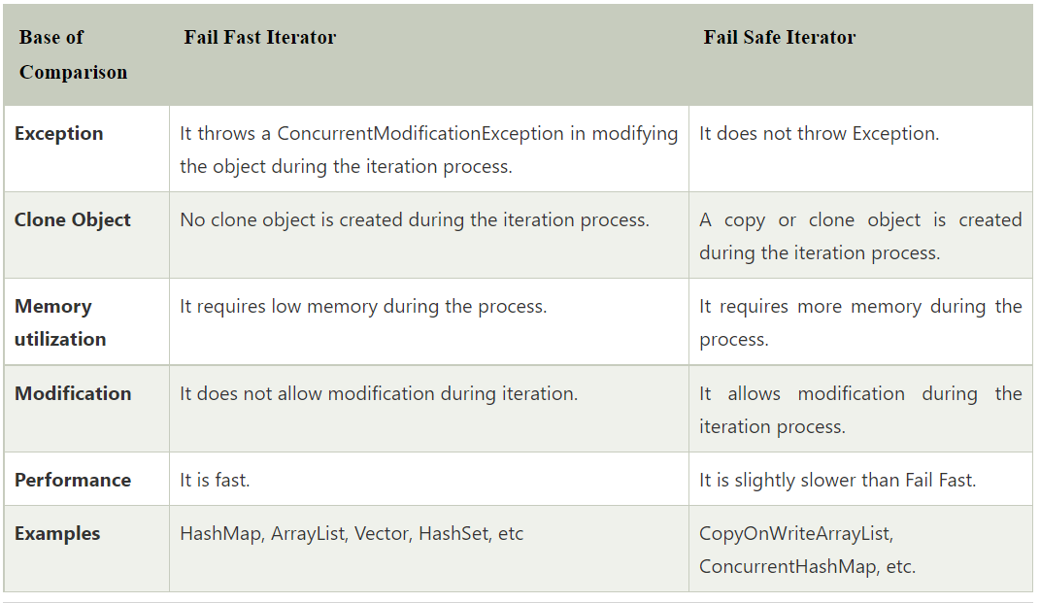

Slide 12
Generics in Java
The Java Generics programming is introduced in J2SE 5 to deal with type-safe objects. It makes the code stable by detecting the bugs at compile time.

Slide 13
Advantage of Java Generics
1) Type-safety
2) Type casting is not required
3) Compile-Time Checking

Slide 14
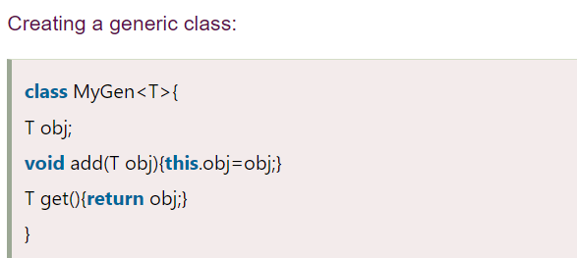
Generic class

Slide 15
Type Parameters
T - Type
E - Element
K - Key
N - Number
V - Value

Slide 16
Bounded Generics
public <T extends Number> List<T> fromArrayToList(T[] a) { ... }

Slide 17
Multiple Bounds
A type can also have multiple upper bounds:
<T extends Number & Comparable>

Slide 18
Generic Method
public class TestGenerics4{
public static < E > void printArray(E[] elements) {
for ( E element : elements){
System.out.println(element );
}
System.out.println();
}
public static void main( String args[] ) {
Integer[] intArray = { 10, 20, 30, 40, 50 };
Character[] charArray = { 'J', 'A', 'V', 'A' };
System.out.println( "Printing Integer Array" );
printArray( intArray );
System.out.println( "Printing Character Array" );
printArray( charArray );
}
}

Slide 19
Wildcard in Java Generics
We can use a wildcard as a type of a parameter, field, return type, or local variable. However, it is not allowed to use a wildcard as a type argument for a generic method invocation, a generic class instance creation, or a supertype.

Slide 20
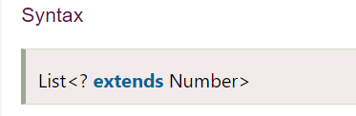
Upper Bounded Wildcards
The purpose of upper bounded wildcards is to decrease the restrictions on a variable. It restricts the unknown type to be a specific type or a subtype of that type. It is used by declaring wildcard character ("?") followed by the extends (in case of, class) or implements (in case of, interface) keyword, followed by its upper bound.

Slide 21
Unbounded Wildcards
When the given method is implemented by using the functionality provided in the Object class.
When the generic class contains the methods that don't depend on the type parameter.

Slide 22
Lower Bounded Wildcards
The purpose of lower bounded wildcards is to restrict the unknown type to be a specific type or a supertype of that type. It is used by declaring wildcard character ("?") followed by the super keyword, followed by its lower bound.
Syntax
List<? super Integer>

Slide 23
THANK YOU
NEEHARIKA

